Slide 1
Dealing with Climate Change:
A moral imperative
Cambria Unitarian Universalist Church, Feb. 10, 2019
Dr. Ray Weymann
ray.climate@charter.et
www.centralcoastclimatescience.org

Slide 2
Outline:
The basic science
Common misconceptions
Climate Impacts
Communicating About Climate Change
What must we do?
Note: Text and slides for this presentation will be posted under Essays on the central coast climate science website: www.centralcoastclimatescience.org

Slide 3
Outline:
The basic science
Common misconceptions
Climate Impacts
Communicating About Climate Change
What must we do?

Slide 4
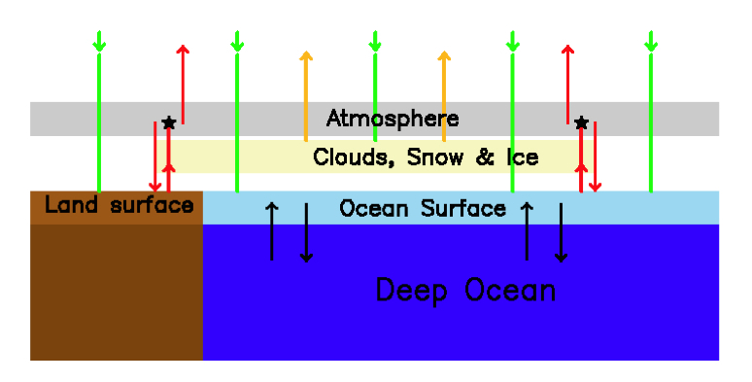

Slide 5
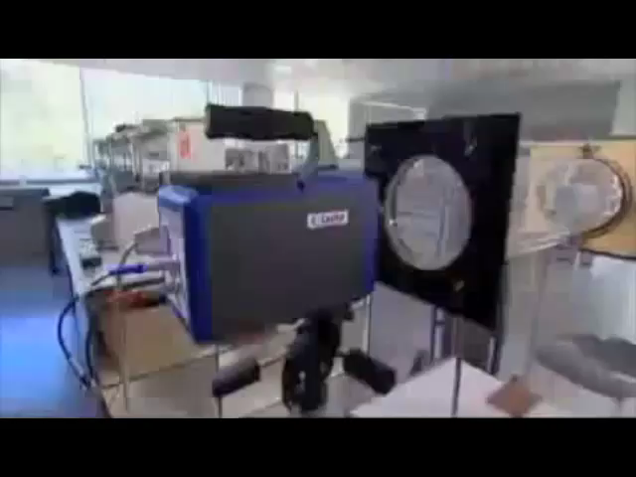

Slide 6
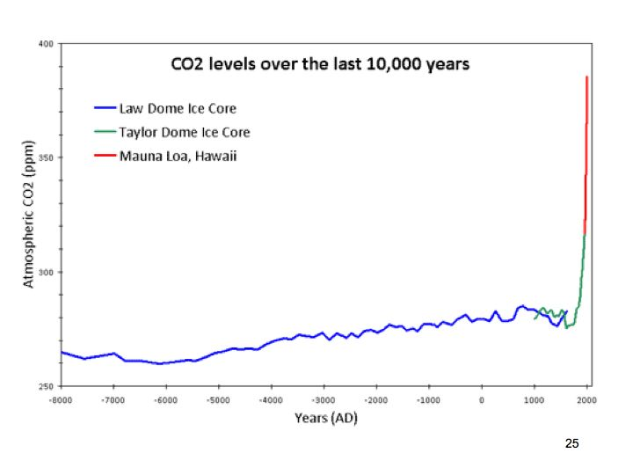

Slide 7
Summary: Basic Science
CO2 traps heat given off by the Earth’s surface that would otherwise escape
The amount of CO2 in the atmosphere has rapidly and dramatically increased and this is unambiguously due to human activity
As a consequence, many pieces of evidence point to a rapidly warming earth, with consequences that are increasingly damaging

Slide 8
Outline:
The basic science
Common misconceptions
Climate Impacts
Communicating About Climate Change
What must we do?

Slide 9
Five Common Misconceptions
The climate has always changed; it’s just part of a natural cycle
The amount of CO2 in the air is way to small to have any effect
Since we get our energy from the sun, it’s the sun that controls climate change
Switching to renewable energy would ruin or economy
The science is uncertain—we should wait until we are sure

Slide 10
Outline:
The basic science
Common misconceptions
Climate Impacts
Communicating About Climate Change
What must we do?

Slide 11
Major Climate Change Impacts
Rising Sea Levels
Increasing drought with intervening episodes of flooding
Hot, dry weather -> Wildfire increases
Increasingly severe tropical storms
Health Impacts: Air quality, spread of disease-carrying insects
Melting glaciers and impact on fresh water
Shifting rainfall patterns, heat, floods: Food supply impacts
Major loss of species; ocean ‘acidification’

Slide 12
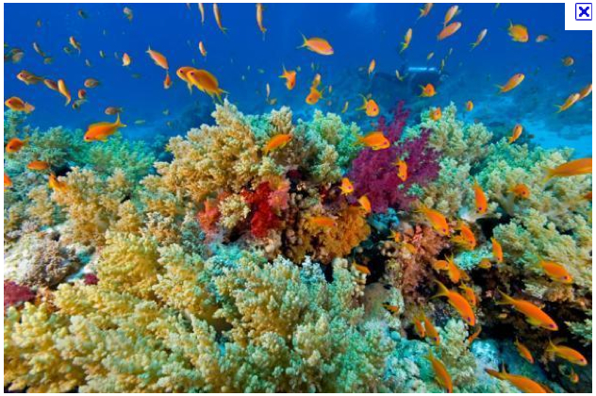

Slide 13
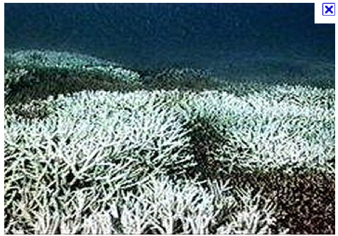

Slide 14
Outline:
The basic science
Common misconceptions
Climate Impacts
Communicating About Climate Change
What must we do?

Slide 15
Advice on communicating climate science:
Know your audience!

Slide 16
To hard core climate deniers:
(slight flippancy department)

Slide 17
To hard core climate deniers
(slight flippancy department)
SAVE YOUR BREATH

Slide 18
To conservative skeptics, but not hard-core deniers

Slide 19
* Establish a non-climate-related personal bond
* Find climate-affected things in common (but don’t fake it) e.g. hunting and fishing
* National Security Interests (arctic ocean, failed states; military infrastructure)
* Free-market solutions and economic opportunities
* High-tech appeal: EVs, Nuclear Energy; Geo-Engineering (but risky)
* Quotes & Examples from those of their “tribe”. (Inglis; Paulson)
A great video illustrating this approach: https://www.yaleclimateconnections.org/2017/01/video-why-facts-arent-enough/

Slide 20
To the open-minded, but un- or mis-informed:

Slide 21
Responding to Myths and Misconceptions
The “inoculation” procedure:
FIRST state the factual situation and THEN explain that this is frequently misunderstood
Briefly state the myth and emphasize that it is myth
Elaborate on the scientific fact
(If this procedure is not followed, people often remember the myth as fact! EXAMPLE: “It’s the sun”

Slide 22
Responding to Myths and Misconceptions
The Scientific Consensus
Due to deliberate efforts by the fossil fuel industry and their think tanks, many citizens still feel that there is significant disagreement among RESEARCH CLIMATE SCIENTISTS about humans causing global warming. THERE IS NOT! 98% agree on what I have presented.
Knowing such a consensus exists is important information to many of the uninformed: If 98 doctors said your child has appendicitis and 2 said not to worry, it’s just a tummy ache, what would you do?

Slide 23
To those who object on religious grounds

Slide 24
An occasional religious objection: “It is fore-ordained…”
2 Peter 3:10:
“But the day of the Lord shall come as a thief, in which the heavens shall pass away with great violence, and the elements shall be melted with heat, and the earth, and the works that are in it, shall be burnt up.”

Slide 25
http://www.christiansandclimate.org/statement/
Excerpts from “Evangelical Climate Initiative: Climate Change: An Evangelical Call to Action: “We commend the 4 simple but urgent claims offered in this document to … our brothers and sisters in the Christian community, and urge all to take the appropriate actions…”
CLAIM 1: Human-Induced Climate Change is Real
CLAIM 2: The Consequences of Climate Change Will Be Significant, and Will Hit the Poor the Hardest
CLAIM 3: Christian Moral Convictions Demand Our Response to the Climate Change Problem
CLAIM 4: The need to act now is urgent. Governments, businesses, churches, and individuals all have a role to play in addressing climate change—starting now.

Slide 26
Religious Statements on
Climate Change
This website has links to nearly every major religious faith, including many Christian denominations:
http://www.interfaithpowerandlight.org/religious-statements-on-climate-change/

Slide 27
Outline:
The basic science
Common misconceptions
Climate Impacts
Communicating About Climate Change
What must we do?

Slide 28
*Reduce your carbon footprint—rooftop solar, low emission cars; home insulation
*Talk to friends, neighbors, grumpy uncles (see ‘communicating about climate’)
*Get involved via local and national organizations (e.g. Citizens Climate Lobby)
* Cambria may consider joining a Community Choice Aggregation group.
*Get involved politically: contribute $$, work for candidates at all levels of government who support action on climate change; make known your wish for action to your representatives at all levels of government. Politics isn’t a dirty word!
*We CAN solve the problem: what we currently lack is the leadership and political will to do so.

